Slide 1
Instructions: In this study, you will view two separate scenarios and then be asked some questions about them. Though the depictions in the materials are suitable for children, we ask that you answer the questions on the basis of what you think and not on the basis of what you think a child might say. Again, we are only interested in what you think.

Slide 2
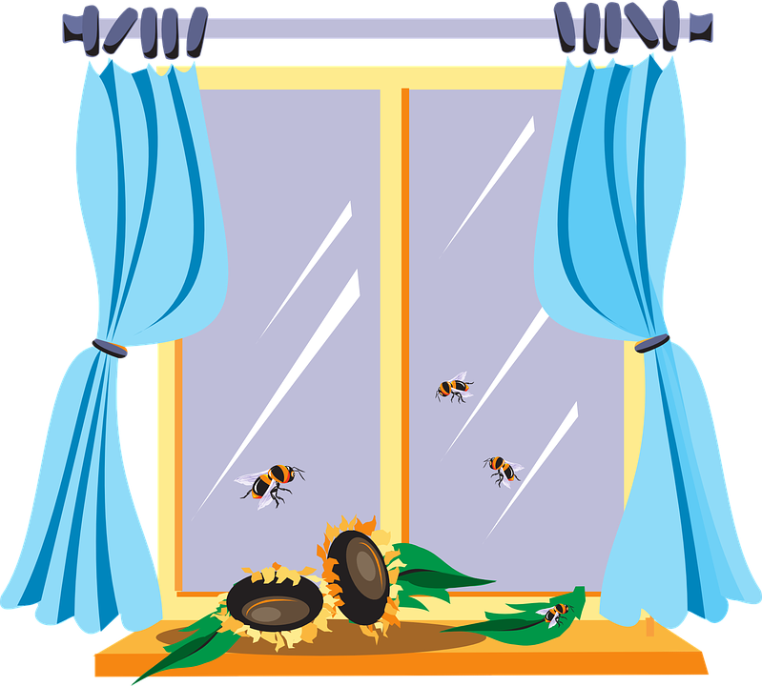
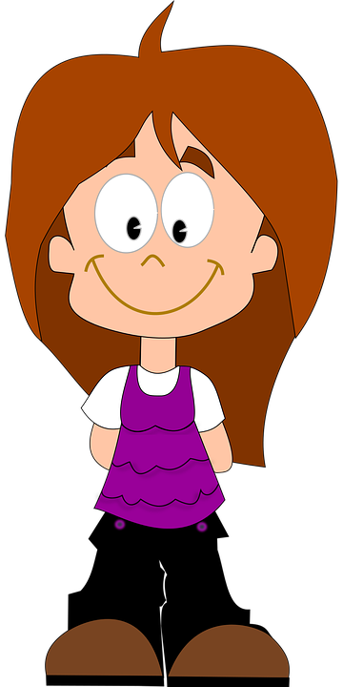

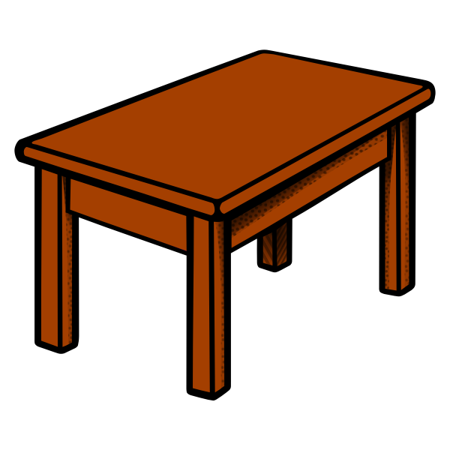


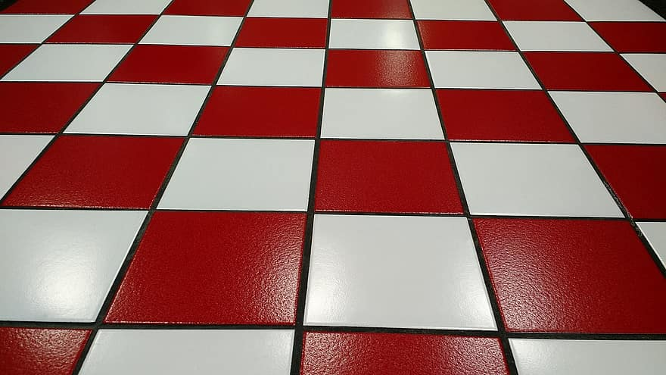
This is Suzy

Slide 3
She is going to go to the beach today.

Slide 4
And she has sunscreen…

Slide 5
and sunglasses to bring with her

Slide 6
She puts on her sunglasses

Slide 7
And then she leaves to go to the beach

Slide 10
Oh no she forgot to take her sunscreen!

Slide 11
See the sunscreen is still on the table

Slide 12
To help you remember that Suzy left her sunscreen at home, this picture will stay at the top of your screen.

Slide 13


Suzy is now at the beach

Slide 14

Do you see that? She is getting a really bad sunburn!

Slide 15
Now that you saw what happened, we will ask you a couple of questions

Slide 16
What caused Suzy’s skin to burn?

Slide 17
What burned Suzy’s skin?

Slide 18
That is the end of the first scenario. You will now view the second, and last, scenario and be asked some questions about.

Slide 19
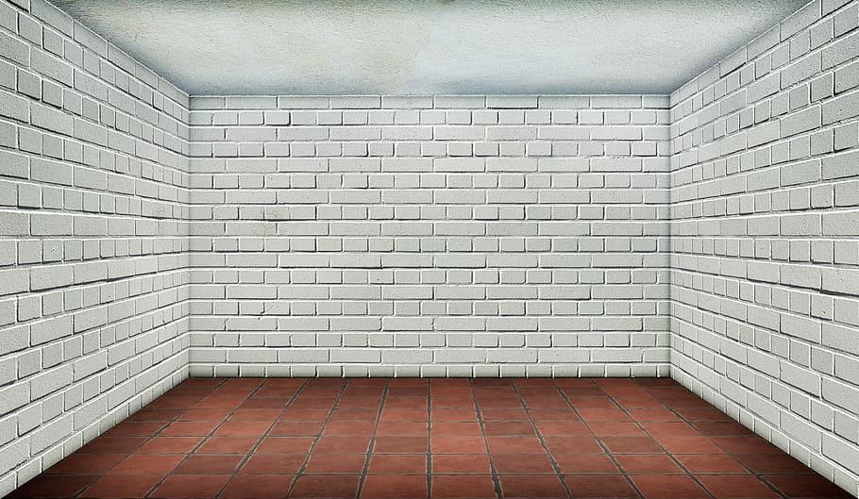

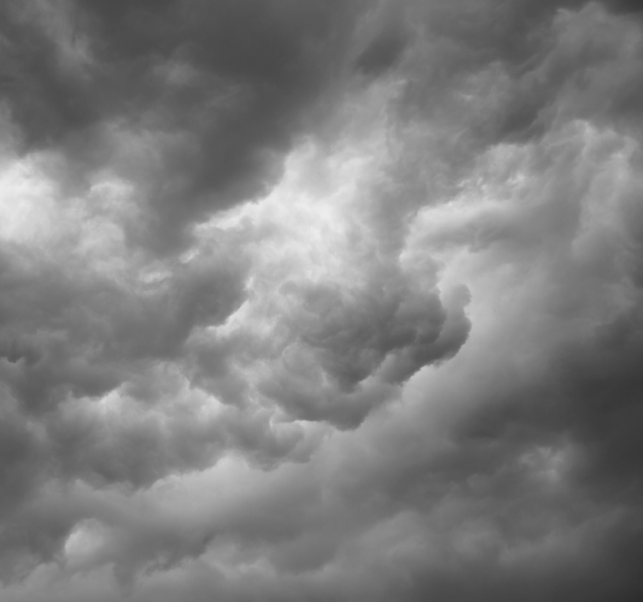
This is Andy
Notes:
.

Slide 20
And this is Andy’s basement window

Slide 21
See the latch on the window?

Slide 22
It is broken!

Slide 23
Andy needs to fix the latch on his basement window

Slide 24
Andy takes the latch off the window so he can fix it

Slide 25
See Andy is holding the latch

Slide 26
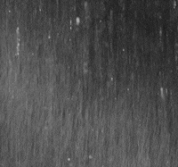

He is now going to fix the latch in his workshop

Slide 27
But oh no it looks like the window is open!

Slide 28
See window is open!

Slide 29

The window is moving back and forth as Andy goes to his workshop

Slide 30



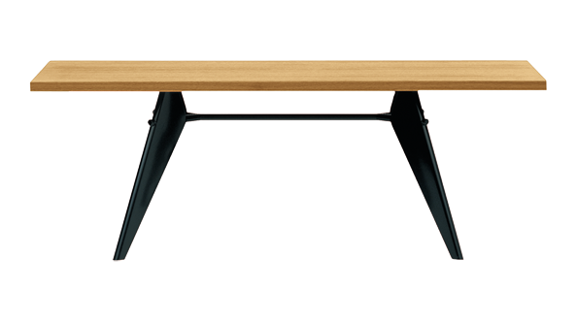
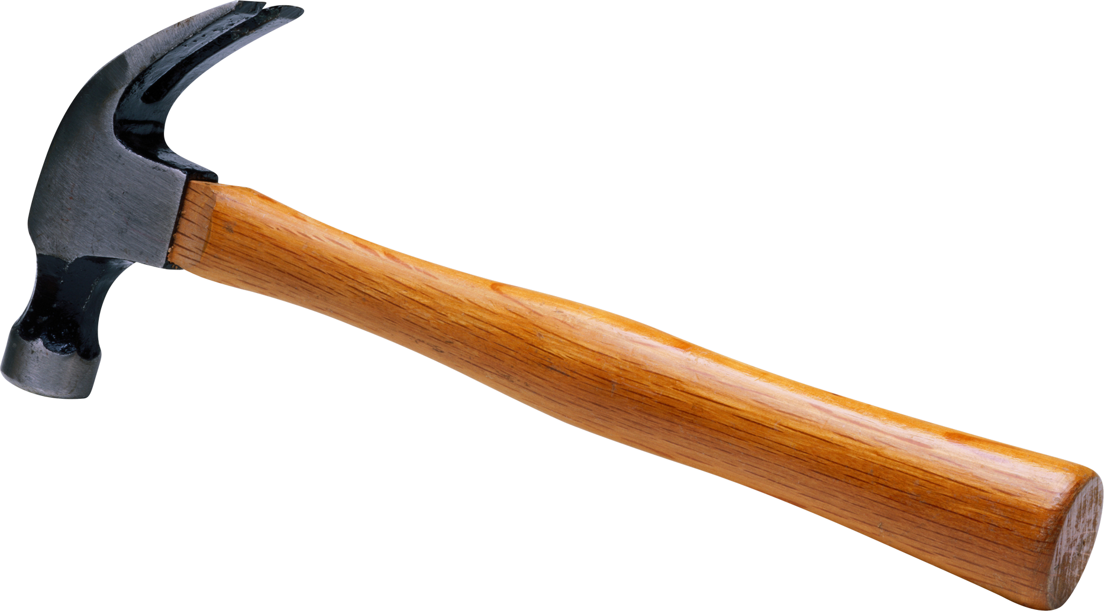
See here is Andy in his workshop with the broken latch

Slide 31
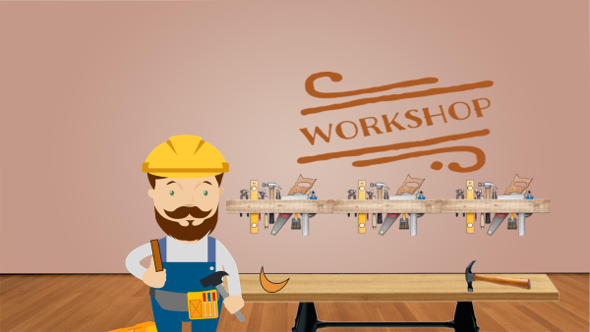
To help you remember that Andy is in his workshop fixing his basement window latch, this picture will remain here on the screen

Slide 32
As Andy is fixing the basement window latch in his workshop it begins raining really hard.

Slide 33
Look the water is getting really high!

Slide 34
Oh no, the window latch is gone!

Slide 35
And the window is open!

Slide 36
The water is coming in the basement!

Slide 40
The basement is flooded!

Slide 41
Now that you saw what happened, we will ask you a couple of questions

Slide 42
What caused the basement to flood?

Slide 43
What flooded the basement?

